Slide 1

MA 336 Artificial Intelligence & Machine Learning Application
Presented by : Mantosh Nandy
Reg No: 2315740
University of Essex, UK

Slide 2
Sentiment Analysis by NLP
NLP – Natural Language Processing
Natural Language Processing (NLP) is a branch of artificial intelligence (AI)
Helps with the interaction between computers and human language.
Uses of NLP: ➢ Speech recognition ➢ Named entity recognition. ➢ Sentiment analysis (in this report we will understand this use case) ➢ Natural language generation (structured speech to text) ➢ Word sense disambiguation ➢ Text classification ➢ Chatbots & Virtual Assistant
Using Python on jupyter notebook.

Slide 3
Introduction
For Analysis purpose we take a dataset from Kaggle.com.
Dataset is Amazon Products Review.csv file
Online reviews have become a must-have for consumers looking to make informed buying decisions.
Manually analyzing sentiment can be overwhelming or we can say it is impossible. That’s where AI and, in particular, Sentiment Analysis techniques (SA) come in.
Why AI? -
Traditional approaches to sentiment analysis typically depend on keyword matching
AI- driven sophisticated advanced algorithms can detect intricate connections among words, phrases, and sentiment, leading to more accurate and insightful analyses.

Slide 4
Analysis of Dataset
This dataset consists of 1597 rows which is considered as data entry and has 27 columns.
Columns name like (id, asins, brand, categories, dateAdded, dateUpdated, name, keys, reviews.sourceURLs, and reviews.text)
It is observed that there are several columns (colors, dimension, reviews.userCity, reviews.userProvince, and sizes) that have significant numbers of null values, which could indicate missing or incomplete data.
To improve the quality of data, need to perform some cleaning tasks. Additionally, we might need to address inconsistencies, outliers, missing values, and data format variations through cleaning and preprocessing steps.

Slide 5
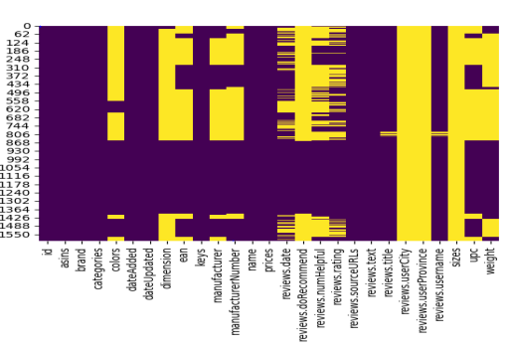
Preliminary Analysis
‘describe ()’ which helps us get a quick overview of the dataset’s distribution, central tendency, and variability.
HeatMap Analysis – it use color intensity to visually represent values, allowing you to quickly identify areas of high or low activity, correlations between variables, and overall data distribution.
        ………..continued

Slide 6
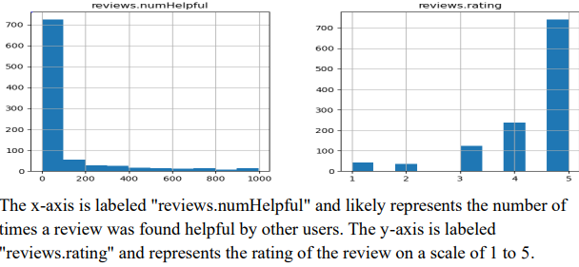
Data Cleansing - applying ‘drop ()’ which helps us to remove the columns which hold null value.
here trying to understand the co relation in between reviews.numhelpful & reviews.ratings which helps us in future for sentimental analysis as it hold the customer`s sentimental reviews.
Based on the available data, there is a slight tendency for reviews with higher ratings to receive more helpful votes, but this trend is not consistent or strong.
A considerable portion of reviews appear in the bottom left corner, indicating that numerous reviews received low ratings and were not deemed helpful by users.

Slide 7
Split the Dataset into Test & Train:
For splitting the dataset, chosen ‘Stratified Shuffle Method’ because to prevent from the heavy bias in our dataset towards one particular section, we implement shuffling after each new data point is inserted. This ensures that no single type of data dominates the training dataset, resulting in a more balanced model that is well-equipped to handle diverse datasets.
a 5-fold stratified shuffle split on the dataset mn_data_after, utilizing the reviews.rating column as the target variable.
Split the dataset on 70:30 portion of training & testing purpose respectively.
strshf_train and strshf_test dataframes are reindexed versions of the original dataset, containing the rows corresponding to the training and testing indices, respectively.

Slide 8
EDA Analysis:
It entails scrutinizing and graphically representing the data, recognizing patterns, outliers, and irregularities, and extracting insights to steer subsequent data analysis and modeling process
Uses of copy () - To prevent accidentally modifying the original data, the first line creates a copy of the strshf_train dataframe and stores it in a new variable named reviews. This ensures the original data remains untouched.
Uses of groupby() – which offers a method to investigate the distinct product names linked with each ASIN in the reviews column. Essentially, it reveals the count of unique product names within each product category identified by the ASIN.
        ………..continued

Slide 9
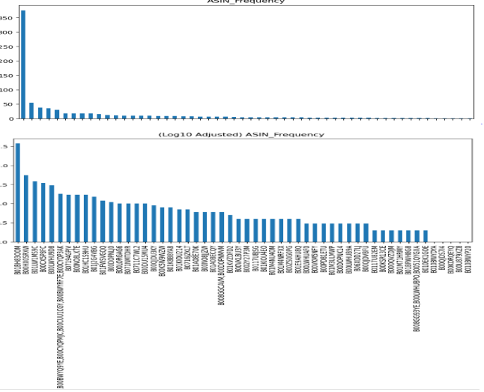
From above first chart observations like : a bar plot of the occurrence frequency counts of the "asins" values in the "reviews" dataset and displays it in the first subplot.
The title of the plot is "ASIN Frequency".
From the second subplot barchart found of the logarithmic (base 10) frequency counts of the "asins" values in the "reviews" dataset and displays it in the second subplot.
which makes it easier to see the distribution of higher frequency "asins” and helps to distinguish between the frequencies of less popular products. So, now we can understand that what asins have max number of people rating. And the answers of which asins have most sales.
………..continued

Slide 10
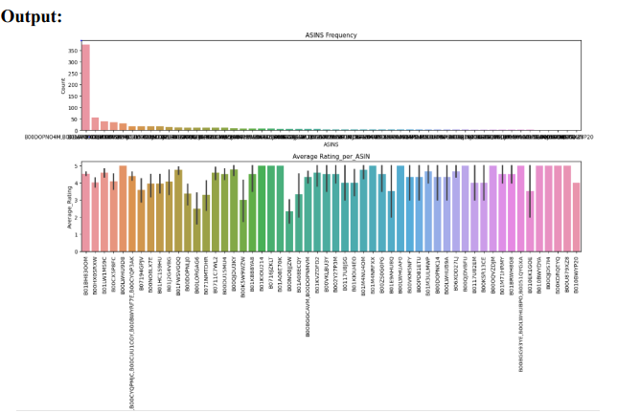
Uses of mean() – found the reviews mean ~4.36
trying to understand how many people giving ratings.
used the tick_params() function in the matplotlib library is used to modification the appearance
This first subplot illustrates a bar chart that displays the number of occurrences for each ASIN in the dataset
The second subplot presents a point plot that illustrates the relationship between ASINs and the average ratings given in reviews.

Slide 11
Sentiment Analysis:
First, define the ‘sentiments’ function where assigns a dictionary called mapping which helps to comment either “positive” or “negative” or “neutral” based on ratings (5,4,….,1). In this code, the use of get () is to retrieve the sentiment corresponding to given rating by the customers.
Now, after declared the sentiment function – its time to applying this function on training & testing dataset. From the above code observed that To analyze the sentiment of review ratings, applying a function called sentiments to the reviews.rating column in both (test & train) datasets using apply(). The outcome is stored in a new column named Sentiments.
Such vectorization provides as a preliminary phase for tasks like text classification, such as sentiment analysis. The vectorized form can subsequently provide input for different machine learning algorithms.
………Continued

Slide 12
TF-IDF transformers reduces the significance of words that appear often across documents (like "the" and "are"). It achieves this by dividing the number of times a word appears in a document by the total number of words in that document.
Why Naïve Bayes? Naive Bayes is a simplest classification technique rooted in Bayes` theorem. Its operation involves determining of a specific event (e.g., a sentiment category) occurring given a collection of features (e.g., words within a review).
Why Support Vector Classifier? SVC, or Support Vector Classification, belongs to the category of supervised machine learning algorithms utilized for classification purposes. Within NLP, it finds application in various text classification tasks like sentiment analysis, spam detection, and topic classification

Slide 13
The provided code establishes a machine learning pipeline employing the Pipeline class sourced from the sklearn.pipeline module. It consists of three stages- vect , tfidf, clf_nominalNB.
The pipeline undergoes training on the training dataset via the fit method, enabling the classifier to learn from the provided data. The training data comprises the x_trn variable, containing the textual information, and the x_trn_targetsentiment variable, holding the associated sentiment labels.
Using NB accuracy score is ~ 86%
This code segment indicates to uses of Support Vector Classifier for trained the dataset. It constructs a pipeline for text classification using LinearSVC as the classifier.
Using SVC accuracy score is ~ 88%

Slide 14
Thank You

